Slide 1




INDUCTION MOTOR FAULT DETECTION USING SVM AND WAVELET TRANSFORM
M JAYESH - CB.SC.U4AIE24128
M RAKESH - CB.SC.U4AIE24134
CH VIRINCHI SAI - CB.SC.U4AIE24158
K JATIN CHANDRA GUPTA - CB.SC.U4AIE24162

Slide 2

INTRODUCTION
Induction motors face operational stresses that lead to faults and failures. Their critical role makes unexpected failures costly. Reliable fault diagnosis is essential, especially with increasing automation reducing direct supervision. Vibration analysis is a widely used and reliable method for diagnosing rotating machine faults, as each fault generates unique vibration patterns. However, traditional techniques like Fast Fourier Transform (FFT) are inadequate for analyzing transient signals.

Slide 3
OBJECTIVES
Develop an Efficient Fault Detection System:
Implement a condition monitoring technique to detect bearing faults in an induction motor.
Utilize Advanced Signal Processing Techniques:
Apply Wavelet Transform for signal analysis to extract relevant fault-related features.
Improve Fault Classification Accuracy:
Use Support Vector Machine (SVM) as a classifier to distinguish between healthy and faulty motor conditions.
Create a Robust and Scalable System:
Develop a fault detection method that can be extended to other types of motor faults.

Slide 4
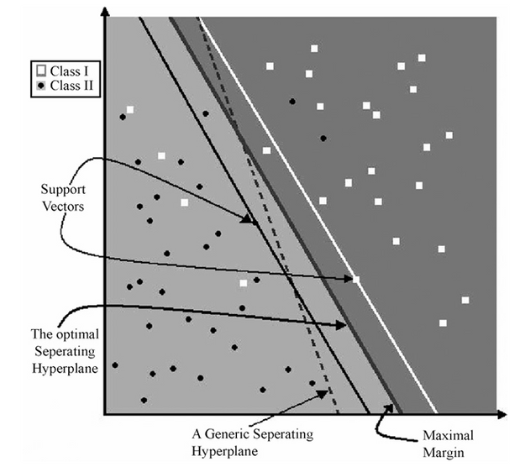
SUPPORT VECTOR MACHINE
SVM is a machine learning algorithm used for classification and pattern recognition.
It works by finding the best boundary (hyperplane) that separates different classes in the data.
Developed from the optimal separating hyperplane under linearly separable conditions.
SVM works by finding a hyperplane that best separates the two classes (Class I: ⚪ white squares, Class II: ⚫ black dots).
We extract features from vibration signals using Wavelet Transform.
These features are used to train an SVM classifier to identify different types of bearing faults (Normal, Ball Fault, Inner Race Fault, Outer Race Fault).
The trained SVM model classifies new vibration signals, helping detect motor faults accurately.

Slide 5
WAVELET TRANSFORM
A wavelet is a special mathematical function used in signal processing.
It helps analyze signals that change over time (non-stationary signals).
Why Use Wavelet Transform?
Unlike Fourier Transform, which only gives frequency information, wavelet transform provides both time and frequency details.
This makes it perfect for studying sudden changes in signals, like motor vibrations during startup.

Slide 6
IMPLEMENTATION
Load Dataset
Preprocessing: Handle Missing Data & Normalize (Clarifies preprocessing steps before feature extraction)
Feature Extraction using Wavelet Transform
Split Dataset into Training and Testing Sets
Standardize Features (Ensures data is ready for training)
Train SVM Classifier
Predict and Evaluate the Model
Display Results

Slide 7
METHODOLOGY
1. Data Acquisition
The dataset consists of multiple CSV files, each representing vibration data for a specific fault condition.
2. Data Preprocessing
Handling Missing Values: NaN/Inf values are replaced with the column mean.
Standardizing Column Sizes: Ensures uniform feature dimensions across all datasets.
Normalization: Min-Max normalization is applied to scale data between 0 and 1.
3. Feature Extraction using Wavelet Transform
Wavelet Transform is applied to extract time-frequency features.
Features like mean, standard deviation, skewness, kurtosis, and energy are computed from wavelet coefficients.

Slide 8
METHODOLOGY
4. Feature Selection using PCA
Principal Component Analysis (PCA) is used to reduce dimensionality while preserving 95% variance.
This step helps in improving the efficiency and accuracy of the SVM model.
5. Splitting the Dataset
The data is split into training (80%) and testing (20%) sets using cross-validation.
6. Training the SVM Model
An SVM classifier with RBF kernel is trained on the extracted wavelet features.
Hyperparameter tuning is done using Grid Search for optimal performance.
7. Model Evaluation and Testing
The trained SVM model predicts fault conditions on test data.
Performance metrics (accuracy, confusion matrix) are used to evaluate the classifier.

Slide 9
COMPONENTS FOR SIMULATION
Induction Machine (Our main machine)
Three-Phase Source (To power the Induction Machine)
Discrete Wavelet Transform (DWT) Block (For feature extraction)
SVM Classifier (For fault detection)
From File Block (To load the dataset)
Scope (To visualize output)
Gain Block
Voltage and Current Measurement Blocks (For analysis)
Power GUI
Mux and Demux

Slide 10
TOOLBOXES USED
Wavelet Toolbox (For Wavelet Transform )
Signal Processing Toolbox (For vibration signal analysis)
Statistics and Machine Learning Toolbox (For SVM classification)

Slide 11
CHALLENGES FACED
Difficulty in Finding Required Blocks
We struggled to locate specific blocks like the Mechanical Load block in Simulink.
Training Data Insufficiency
If the SVM is trained with a limited dataset, it might not generalize well.
Increase the dataset size and ensure proper feature selection.

Slide 12
UID for the Website
The UI design of our Bearing Fault Detection System will focus on simplicity, clarity, and ease of use. The website will have an intuitive layout to ensure a smooth experience for users.
Home Page: Overview of the project and its importance.
Upload Data Page: Allows users to upload CSV files containing vibration data.
Preprocessing & Feature Extraction: Automatically processes the uploaded data using Wavelet Transform.
Fault Prediction: Runs the trained SVM model on the uploaded data and displays results.
Visualization: Shows graphs like wavelet decomposition plots, confusion matrix, and vibration signals.
Download Report: Provides an option to download results as a PDF or CSV file.

Slide 13


